Slide 1


WHY
GREATER COPENHAGEN
& SOUTHERN SWEDEN?
WHY
GREATER COPENHAGEN
& SOUTHERN SWEDEN?

Slide 2
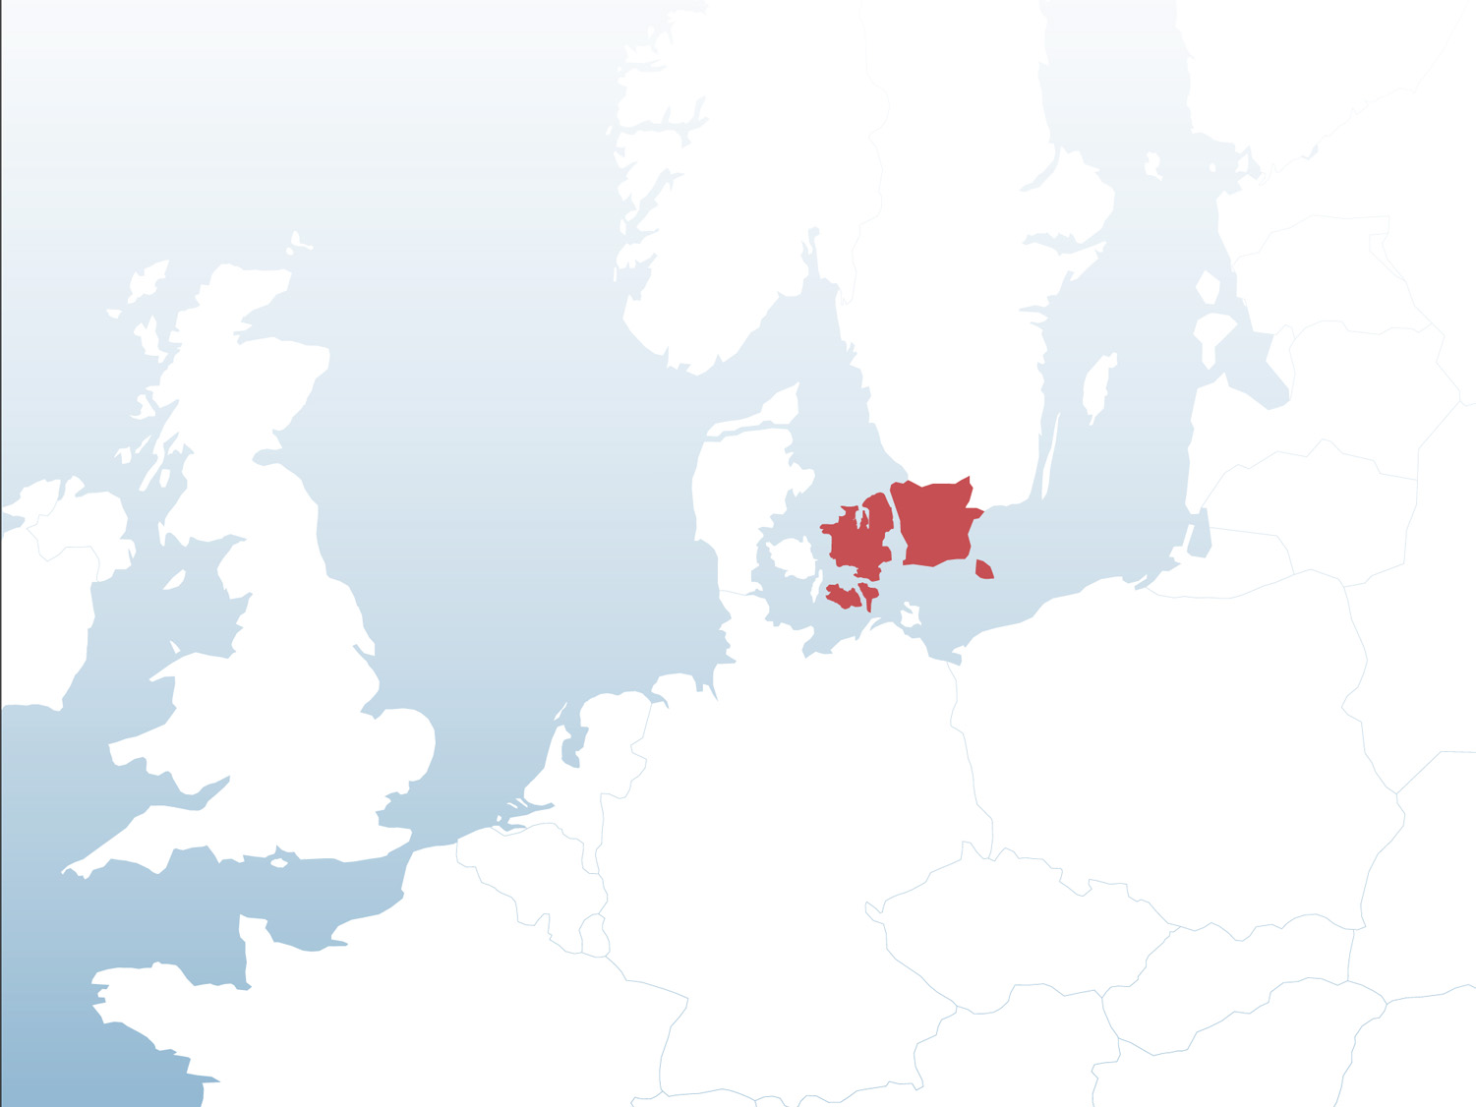
A WORLD CLASS REGION FOR
BUSINESS AND INNOVATION
A knowledge-intensive ecosystem
Sweden
World leaders in innovation
Home to
MAX IV and ESS
DENMARK
Superb work-life balance
Scandinavian creativity, sustainability, openness
and trust
germany
Notes:
The greater Copenhagen area in eastern Denmark together with the southernmost part of Sweden, Skåne, is the most densely populated region in Scandinavia with nearly 4 million inhabitants. It is one of the best environments in the world for research, development and innovation within materials and life sciences.
- We have a knowledge-intensive eco-system featuring accelerators, incubators, science parks and test bed facilities and it is a world leader in innovation.
(Example: The European Innovation Scoreboard ranked Sweden as the most innovative country on the Continent in 2017)
- It’s home to the brightest x-ray light source in the world, MAX IV, and soon the most powerful neutron source, the European Spallation Source – ESS.
- Also, our region has much more to offer that is beneficial for businesses and people – it’s about everything Scandinavian: creativity, sustainability, trust, openness, opportunity
- A superb work-life balance
This is where Sweden meets Denmark and Scandinavia meets the world. This is where you need to be, and I will now tell you why.
Illustration: Invest in Skåne

Slide 3

KEY REASONS FOR CHOOSING
OUR REGION
01 Scientific talent and advanced research facilities
02 An area of innovation and collaboration
03 Excellent infrastructure and accessibility
04 Exceptional work-life balance
Notes:
These are the 4 key reasons why you should consider this region for your future business or investment plans.
Scientific talent and advanced research facilities
An area of innovation and collaboration
Excellent infrastructure and accessibility
Exceptional work-life balance

Slide 4

Scientific talent and advanced research facilities
01
Notes:
Credits: Invest in Skåne/Apelöga

Slide 5
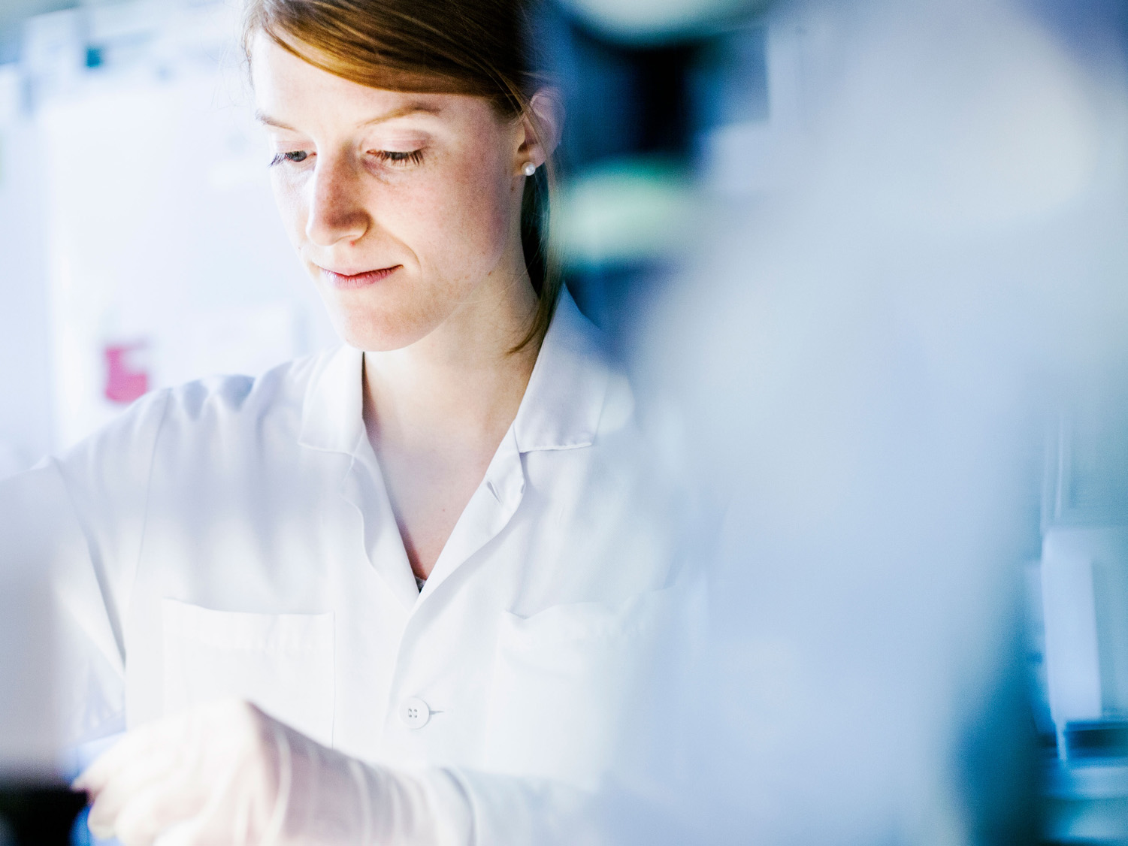
ACCESS TO TALENTED PEOPLE
High number of top scientists and skilled research staff
Ensures top recruits
for your company’s talent needs
A network of highly qualified mediator companies
Notes:
In the region there is a great number of highly skilled, English speaking, university and company scientists and researchers sharing an innovative R&D culture. This ensures top recruits and skills for your company’s needs.
Add in a large number of skilled, highly trained mediator companies with direct access to research facilities, and it becomes very easy to outsource experimental and research operations in a quick and cost-effective way.
Examples of mediator companies are Saromics, Colloidal Resource and Adroit Science.
Credits: Invest in Skåne/Apelöga

Slide 6
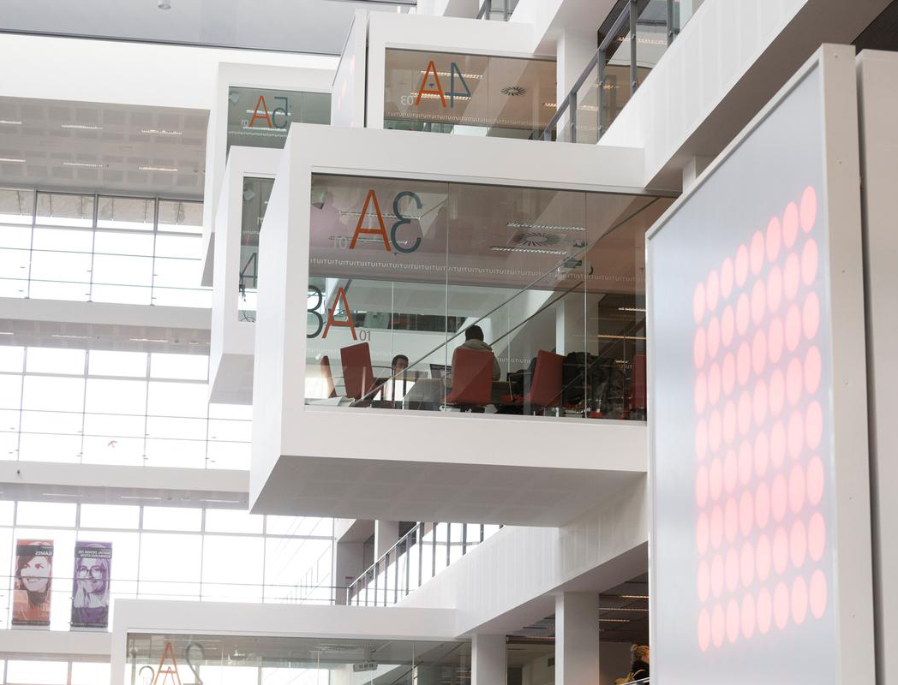
17 universities
and higher education faculties
14,000
researchers
6,500
PhD students
19 science parks
Notes:
We have 17 universities of which 4 are ranked among the top ones in the world, for instance Lund University, one of northern Europe’s oldest and the largest university in Sweden.
The University of Copenhagen is Denmark's largest research and educational institution with nearly 35,000 students.
The Danish Technical University is one of the highest ranked technical universities university in Europe.
14,000 Researchers in a wide range of disciplines (at universities)
6,500 PhD students
This makes it easy for international companies conducting cutting-edge research to find and access the exact skills they require for their specific research projects.
Image: Copenhagen University/Credits: Nicolai Perjesi

Slide 7
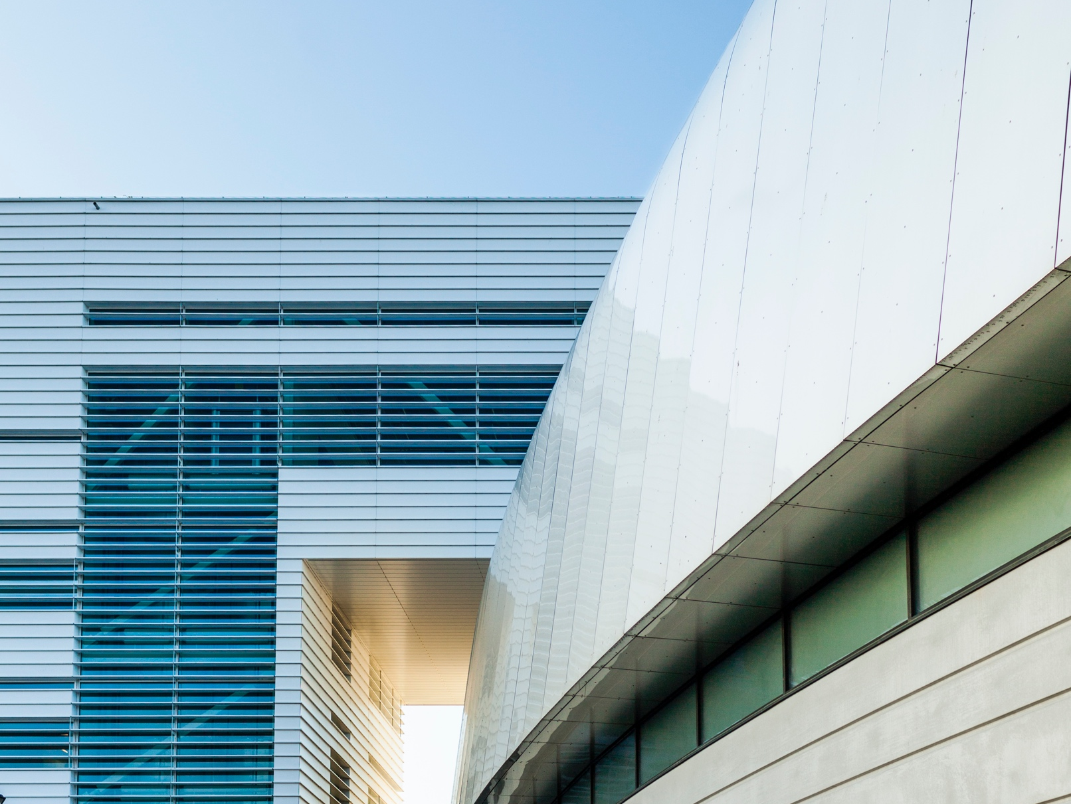
STATE-OF-THE-ART RESEARCH FACILITIES MAX IV & ESS
Enables scientists to carry out more and and wider ranging experiments
Help shorten lead times
Provide complex, fully R&D programs at one location
Notes:
MAX IV and the European Spallation Source are located just outside of Lund. Together, they will serve as the two most brilliant light sources in the world and will lead research within materials and life sciences for decades to come.
The facilities will enable scientists to perform more and wider-ranging experiments than at any similar facility in the world.
The researchers using them will help shorten the time span conducting experiments and potentially build an R&D advantage over competitors in other countries using similar research infrastructure.
They will provide complex, fully integrated R&D programs in one place.
MAX IV is already operational and the European Spallation Source is expected to be in use in 2023.
Credits: Invest in Skåne/Apelöga

Slide 8

A perfect environment for test-beds for market commercialization
Notes:
Our region is characterized by early adopters, innovations and new technology.
This makes it the perfect environment for test beds for commercialization operations that are close to R&D operations.
Credits: Melker Dahlstrand/imagebank.sweden.se

Slide 9
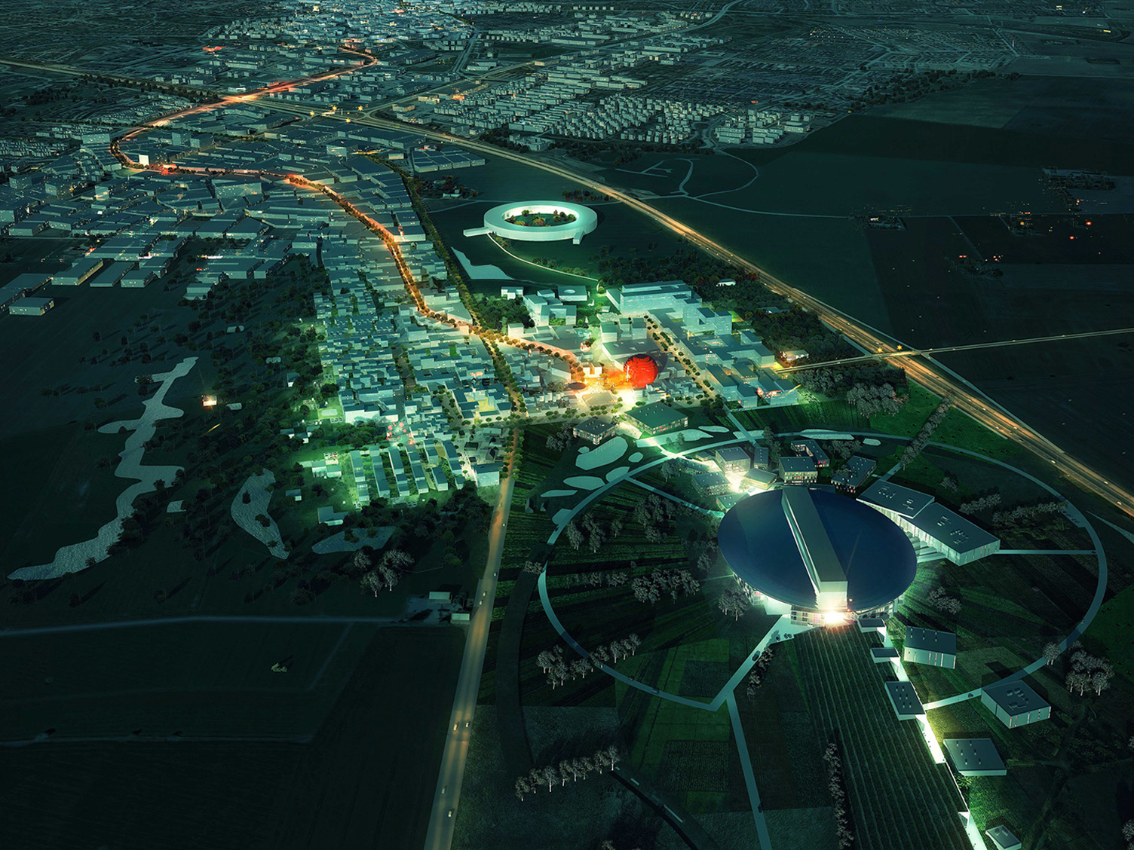
An area of innovation and collaboration
02
Notes:
Credits: The European Spallation Source

Slide 10

Cooperation between industry, academia
and the public sector
A fertile and dynamic area for science and business development
Open innovation model
Notes:
The region has an R&D culture characterized by non-hierarchy, collaboration, knowledge sharing, transparency, openness and an entrepreneurial drive.
We have a long tradition of cooperation between industry, academia and the public sector – something called the Triple Helix Model. This model has proven successful in generating new formats for knowledge and skills production, technology transfer and application. It also boosts co-funding opportunities between public and private entities.
Accelerators, business incubators, science and technology parks build an arena combined with specialized academic research centres which make this a fertile and dynamic area for science and business development.
(Some examples include COBIS, Ideon Science Park, Medicon Village, Medeon Science Park & Incubator, Medicon Valley Alliance, Krinova, MINC)
It allows companies to easily plug into the open innovation model: share, cooperate and grow.

Slide 11
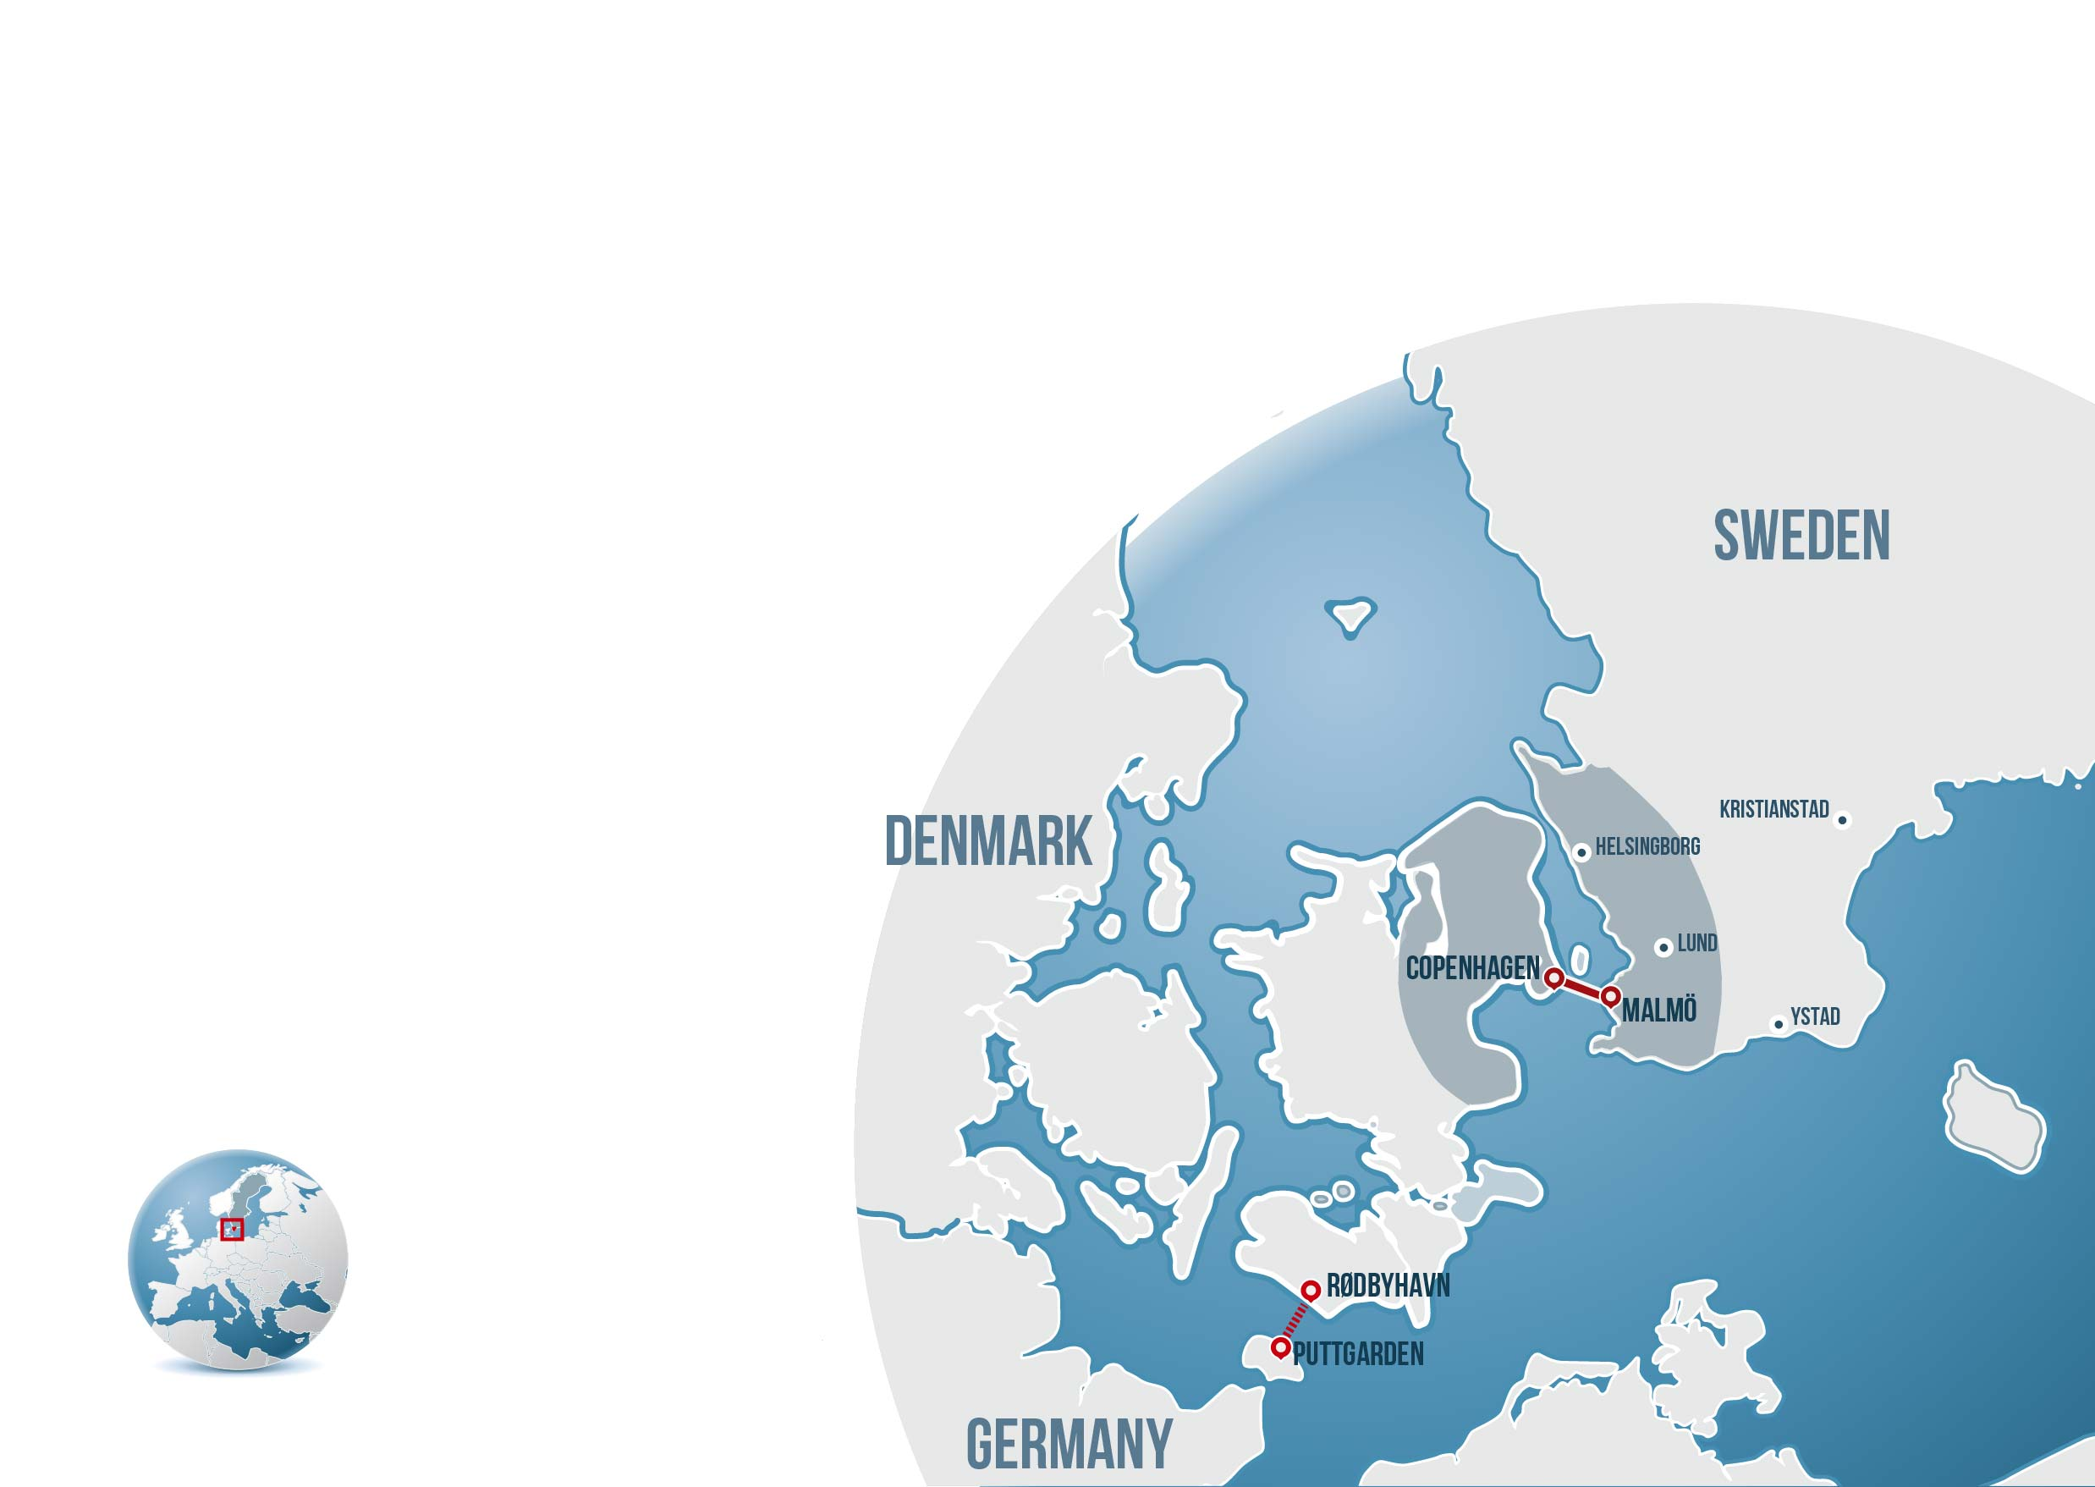
03
EXCELLENT INFRASTRUCTURE
AND ACCESSIBILITY
Notes:
The infrastructure and accessibility in this area is excellent.
Thanks to the Öresund Bridge connecting southern Sweden and Copenhagen, and made famous by the detective series “The Bridge”, transport in the region is easy with trains running at least every 20 minutes.

Slide 12
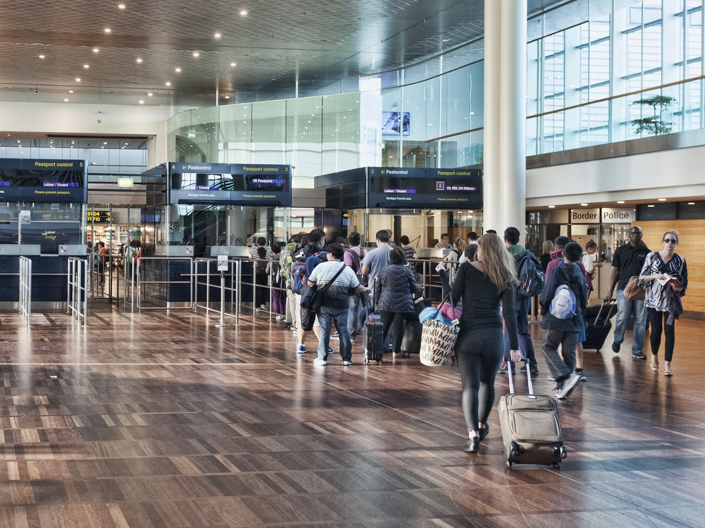
Scandinavia’s largest
air travel hub
– Copenhagen Airport
Copenhagen Malmö Port
Enable smooth, fast transfer of staff and cargo world wide
Notes:
Copenhagen International Airport is Scandinavia’s largest air travel hub with direct flights to key cities in North America, Asia and Europe.
From Malmö Central station, the airport and the centre of Copenhagen are reachable within around 20 minutes via a direct train.
Copenhagen Malmö Port is one of the biggest port and terminal operators in the Nordics, one of the largest Northern European cruise-ship ports and occupies a key position in the Baltic Sea Region for the distribution of cars and transit oil.
This enables a smooth, fast transfer of staff and cargo worldwide.

Slide 13
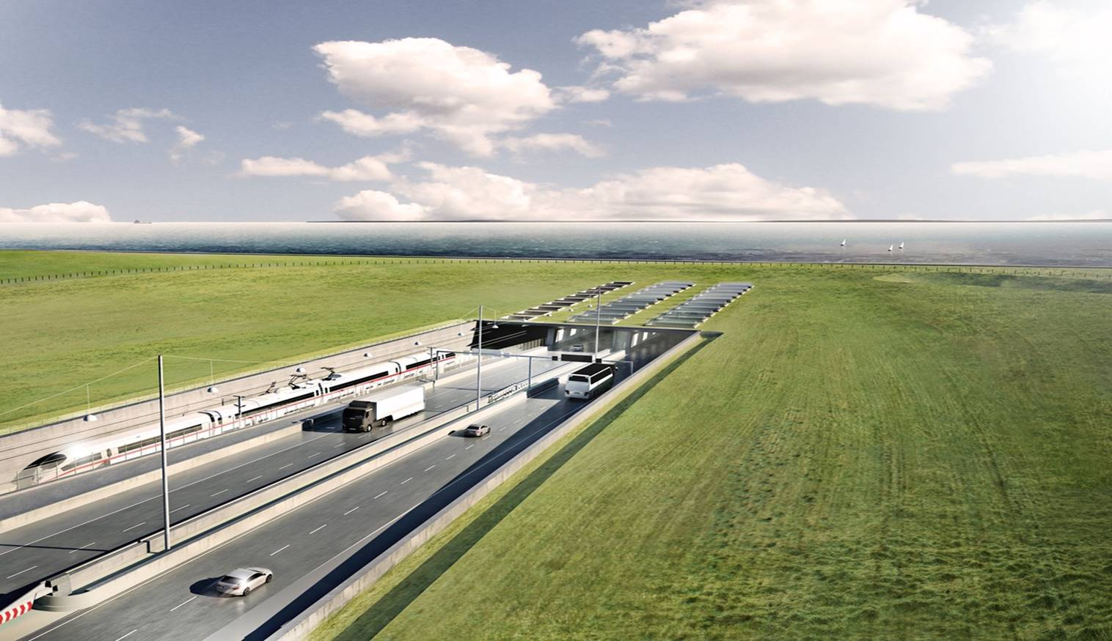
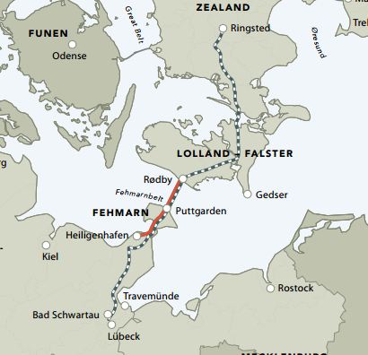
2028 THE FEHMARN BELT
– a fast, seamless access
to Germany and other European markets
Notes:
The region borders large European countries such as the Baltics, Poland and Germany. Many companies place their logistics hubs here to serve the whole region.
The Fehmarn Belt link, a tunnel between Rödby in Denmark and Puttgarten in Germany, is expected to be operational by 2028. It will provide swift access to Germany and other European markets.
Once completed, the journey between Denmark and Germany will take 7 minutes by train and 10 minutes by car.
That means you will be able to travel from Stockholm to Hamburg in just nine hours and from Malmö to Hamburg in approx. three hours.

Slide 14

INTERNET ACCESS & CONNECTIVITY
The region is ranked among the world’s best for fast internet access and connectivity
Enables sophisticated and rapid transfer of large quantities of data
Notes:
Skåne and the metropolitan region Greater Copenhagen area rank among the world’s best for fast internet access and connectivity in a recent report by the Financial Times – fDi European Cities and Regions of the Future 2018/19.
The region also scored highly at the city level, with the cities Lund and Malmö ranking first and third, respectively, as the best small European cities for connectivity.
Among mid-sized European regions, the metropolitan region Greater Copenhagen placed fourth for connectivity.
This enables sophisticated and rapid transfer and analysis of very large quantities of data.
Credits: Adobe Stock

Slide 15

Exceptional work-life balance
04
Notes:
Our region is not only an excellent place for business but offers also a superb quality of life with some of the world’s best social benefits.
Credits: Simon Paulin/imagebanksweden.se

Slide 16

DENMARK & SWEDEN
Two countries with some of the world’s highest living standards
Openness, sustainability and trust
Transparency and the lowest corruption rate in the world
Notes:
In Sweden and Denmark, openness, stability, sustainability and living standards are without comparison.
The public sector is efficient, transparent and both Sweden and Denmark are among the five least corrupted nations in the world
These are factors that we believe are necessary for innovation and business opportunities.
(Facts: Sweden and Denmark are in the top 5 of least corrupt nations out of 175 countries, according to the 2017 Corruption Perceptions Index reported by Transparency International)
Credits: Simon Paulin/imagebanksweden.se

Slide 17

EXCEPTIONAL QUALITY OF LIFE
Wide choice of reasonably priced accommodation
Short distance between city centres and recreational areas
Long-term
human resourcing, employee creativity
and productivity
Notes:
Besides having a fantastic infrastructure for research and business, our region offers a chance to enjoy a high quality of life.
There’s a wide selection of reasonably priced accommodation in safe areas that are close to your work.
It is often just a 15 minute journey from the city centre to big-city shopping districts, and a great cultural scene as well as to the unspoilt countryside and some of the finest sandy beaches in this part of Europe.
The quality of life fosters long-term human resourcing, employee creativity and
productivity.
Credits: Simon Paulin/imagebanksweden.se

Slide 18

EXCELLENT INTERNATIONAL EDUCATION SYSTEM
Subsidized kindergartens & schools
High quality education in English
Commuting is easy which facilitates the family situation.
Notes:
We have an excellent international education system.
There are lots of private (subsidized) and international kindergartens, schools and universities offering high-quality education in English on both sides of the Öresund Bridge.
Several schools offer International Baccalaureate, achieving very high results compared with the European average.
Commuting is easy in this region with few traffic queues and efficient public transport which facilitates the family situation and shortens travel times.
Credits: Lena Granefelt/imagebanksweden.se

Slide 19

SOME OF THE WORLD’S BEST SOCIAL BENEFITS
Minimum 5 weeks paid annual vacation
480 days parental leave (per child)
Subsidized healthcare
Notes:
There’s no better place to bring up children than in Sweden or Denmark and the countries have some of the world’s best social benefits.
For instance:
- Minimum 5 weeks paid annual vacation
- Parental leave in Sweden is probably the most generous in the world with 480 days of paid parental leave (per child)
Health care is practically free, and of an excellent standard
Credits: Simon Paulin/imagebanksweden.se

Slide 20

SUMMARY
World-class research & global hotspot
Knowledge-intensive eco system
Superb quality of life
This is Scandinavia at its best, this is where you need to be!
Notes:
As you can see, from the superb quality of life, to the knowledge-intensive eco system featuring world-class research at universities, research facilities and companies, this region is a global hot-spot for scientists, innovators and entrepreneurs shaping the products of tomorrow.
This is Scandinavia at its best, this is where you need to be!
Credits: Miriam Preis//imagebank.sweden.se

Slide 21
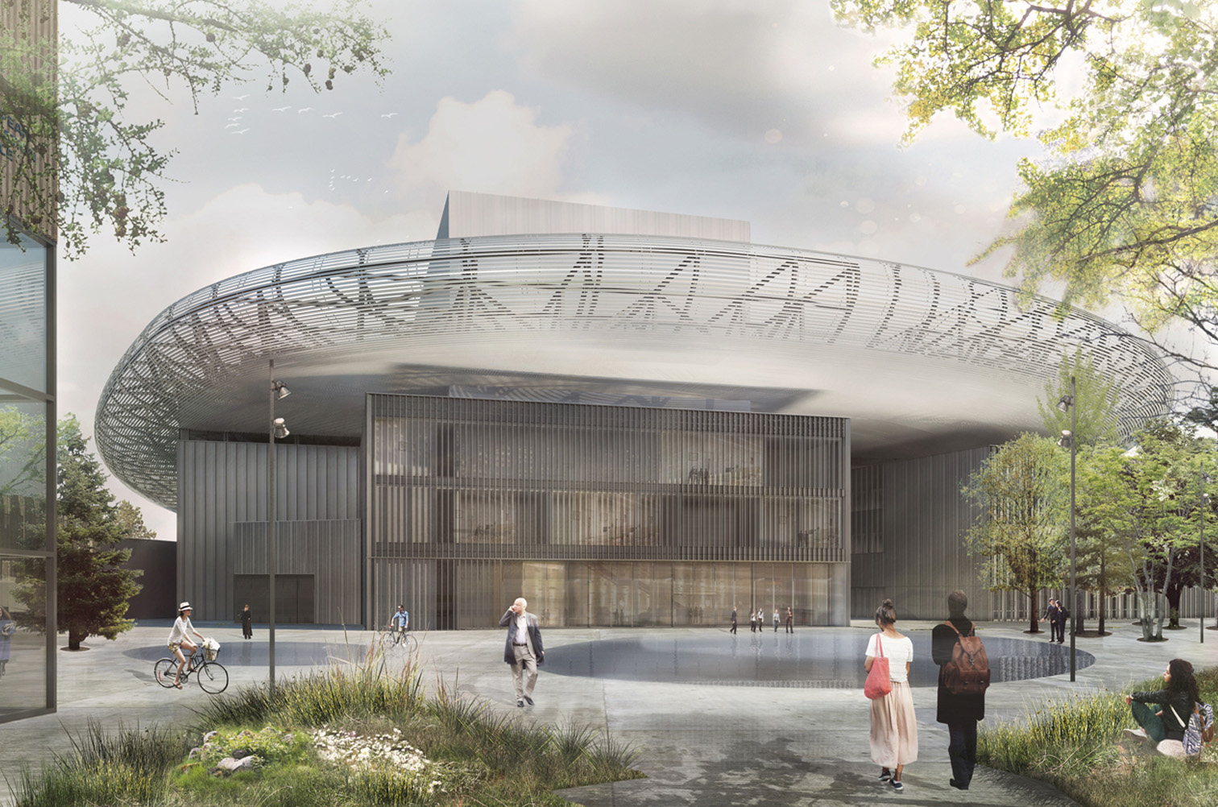
THANK YOU!
Find more information at
http://www.copcap.com/
http://investinskane.com
Visualization: European Spallation Source

